Slide 2
Unit 3: Continuous System (8 hrs)
3.1 Introduction To Continuous System
3.2 Representation Of Continuous System Using Differential Equation
3.3 Linear And Nonlinear Differential Equations And Its Examples
3.4 Analog Computer (Components And Examples)
3.5 Digital Analog Simulators
3.6 Hybrid Computers
3.7 CSSLs, CSMP III
3.7.1 Structured Statement
3.7.2 Data Statements
3.7.3 Control Statements
3.8 Feedback System With Example
3.9 Interactive System

Slide 3
Hybrid Computers
A hybrid computer is a digital computer that accepts analog signals, converts them to digital form, and processes them as digital data.
These computers may be utilized to simulate systems that are primarily continuous but also incorporate some digital elements.
Hybrid computers are mainly used in specialized applications where both discrete and continuous data need to be processed.

Slide 4
Hybrid Computers Example
A petrol pump features a processor that converts fuel flow measurements into quantity and price values.
In a hospital's Intensive Care Unit (ICU), an analog device measures a patient's blood pressure and temperature. These measurements are then converted and displayed as numerical values.
Hybrid computers are beneficial when studying systems that can be effectively represented by an analog computer model over a repetitive period.

Slide 5
Hybrid Simulation
Sometimes, a simulation model may not exhibit only continuous behavior; it can also display discrete characteristics.
In such cases, the system being simulated is a combination of continuous and discrete elements.
This can be effectively modeled using a hybrid simulation, which links analog and digital computers together.

Slide 6
Hybrid Simulation
High-speed processing is required to convert signals from one form of representation to another.
The term "hybrid simulation" typically refers to the integration of functionally distinct analog and digital computers for the purpose of simulation.

Slide 7
Digital Analog Simulators
Digital analog simulators use programming languages on digital computers to simulate continuous systems.
These allow a continuous model to be programmed on a digital computer in the same way as it is solved on an analog computer.
These languages contain macro instructions acting as adders, integrators, and sign changers.

Slide 8
Digital Analog Simulators
A program uses macro-instructions to connect components like how operational amplifiers are linked in analog computers.
Over time, more advanced techniques have emerged for using digital computers to simulate continuous systems.
As a result, digital-analog simulators are now infrequently used.

Slide 9
Continuous System Simulation Language
Continuous system simulation languages are high-level programming languages that facilitate the modelling and simulation of systems characterized by ordinary and partial differential equations.
CSSLs help to model and study continuous systems formulated as block diagrams or in Ordinary Differential Equations(ODEs).
These languages utilize a familiar type of input for digital computers that enables users to program directly from mathematical model equations instead of breaking them down into functional elements.

Slide 10
Continuous System Simulation Language
A Continuous System Simulation Language (CSSL) employs macros and subroutines to replicate the functions of specific analog elements, offering the convenience of an analog simulator.
It includes algebraic and logical expressions to describe variable relationships and thus removes the orientation towards linear differential equations, which characterizes analog computers.
An example of a CSSL is the Continuous System Modeling Program (CSMP-3).

Slide 11
Continuous System Simulation Language
Vehicle Development: Used in the fields of hydraulic systems(injection pumps, breaks), vehicle-ground interactions, dynamics of accident, etc.
Missiles: Can be used in autopilot mechanisms, flight systems, all kinds of control loops, etc.
Peripheral System for Computers: Can be used in electrical-mechanical interaction, disk drives, pen drives, printers, etc.
Environmental Analysis: Can be used in the field of environmental analysis growth of plants, the spread of harmful substances, etc.
Chemical Processes: Can be used in the study of diffusion process, in heat-exchangers, chemical plants, etc.
Electrical Supply: Can be used in power plants, pumps, power distribution plants, control loops, etc.

Slide 12
CSMP III
Continuous System Modeling Programming III
A CSMP III program is constructed from three general types of statements:
Structural Statement
Data Statement
Control Statement

Slide 13
CSMP III
Structural Statement
This statement defines a model composed of statements and functional blocks similar to FORTRAN, designed for operations commonly found in model definitions.
It utilizes the same notations and rules as FORTRAN for performing operations such as addition, subtraction, multiplication, division, and exponentiation.

Slide 14
CSMP III
Structural Statement
For example: if model equation is X = 6 Y / 10 +(Z-2)²
Then this statement is used: 6.0 * Y / 10 + (Z - 2) * * 2.0
Real constants have decimal notations. Exponential notations can also be used.
Example: 1.2e⁴ = 1.2 * 10⁻⁴ =0.00012.
Fixed value needs declaration, variable name must be six characters or less. Example: PI=3.14159

Slide 15
CSMP III
Data Statement
This statement defines the numerical values of parameters, constants, and initial conditions.
ICON can be used to set the initial value of the integration block function.
CONST can be used to set values for a constant.
PARAM is used to set parameters for an individual.
It can also be used to set a series of numeric values for one parameter.
Example: CONST A =0.5, XDOT = 1.25, YDOT=6.22
PARAM D=(0.25, 0.50, 0.75, 1.0)

Slide 16
CSMP III
Control Statement
This statement specifies the option in the execution of the program and the choice of the output. TIMER is used to specify the timer interval.
Example: TIMER DELT = 0.005, FINTIM=1.5, PRDEL = 0.1, OUTDEL = 0.1
Where DELT= Integration interval
FINTIM = Finish time
PRDEL= Interval at which print results
OUTDEL= Interval at which to print plot

Slide 17
CSMP III
Control Statement
If printed or print-plotted output is required, then the control statement with the words PRINT and PRTPLT is used, followed by the names of variables to form the output. TITLE and LABEL can be used to put headings on the output.

Slide 18
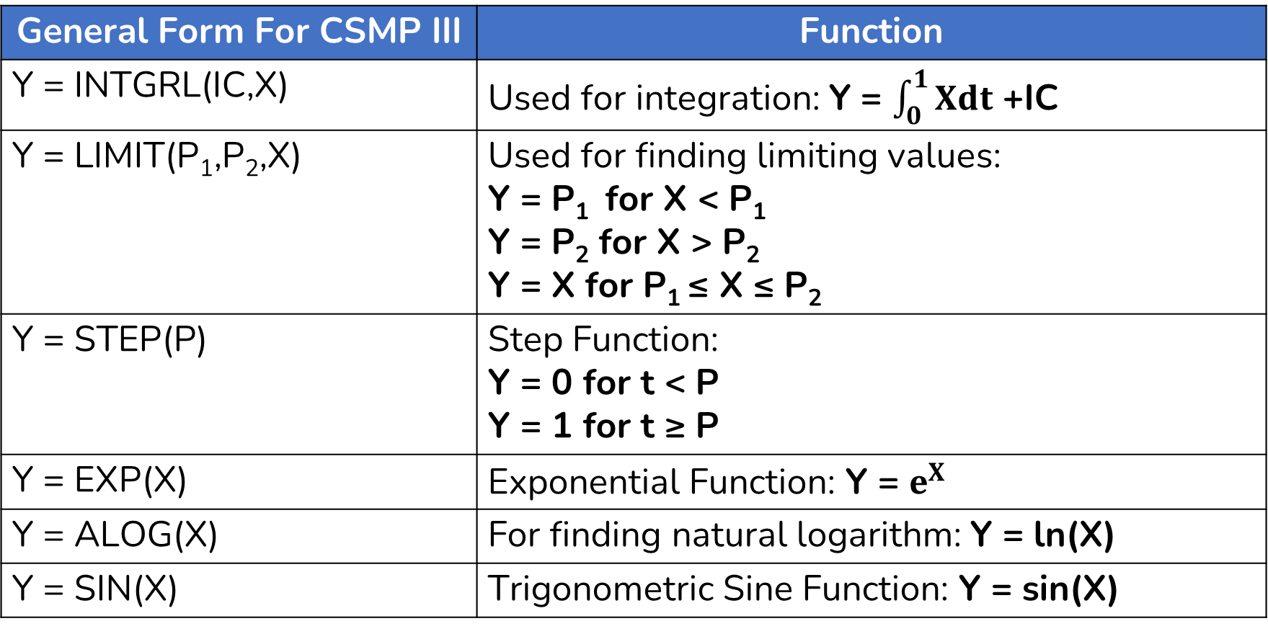
CSMP III Functional Blocks
General Form For CSMP III | Function
Y = INTGRL(IC,X) | Used for integration: Y = $\int_{0}^{1}{Xdt}$ +IC
Y = LIMIT(P₁,P₂,X) | Used for finding limiting values: Y = P₁ for X < P₁ Y = P₂ for X > P₂ Y = X for P₁ ≤ X ≤ P₂
Y = STEP(P) | Step Function: Y = 0 for t < P Y = 1 for t ≥ P
Y = EXP(X) | Exponential Function: Y = $e^{X}$
Y = ALOG(X) | For finding natural logarithm: Y = ln(X)
Y = SIN(X) | Trigonometric Sine Function: Y = sin(X)

Slide 19
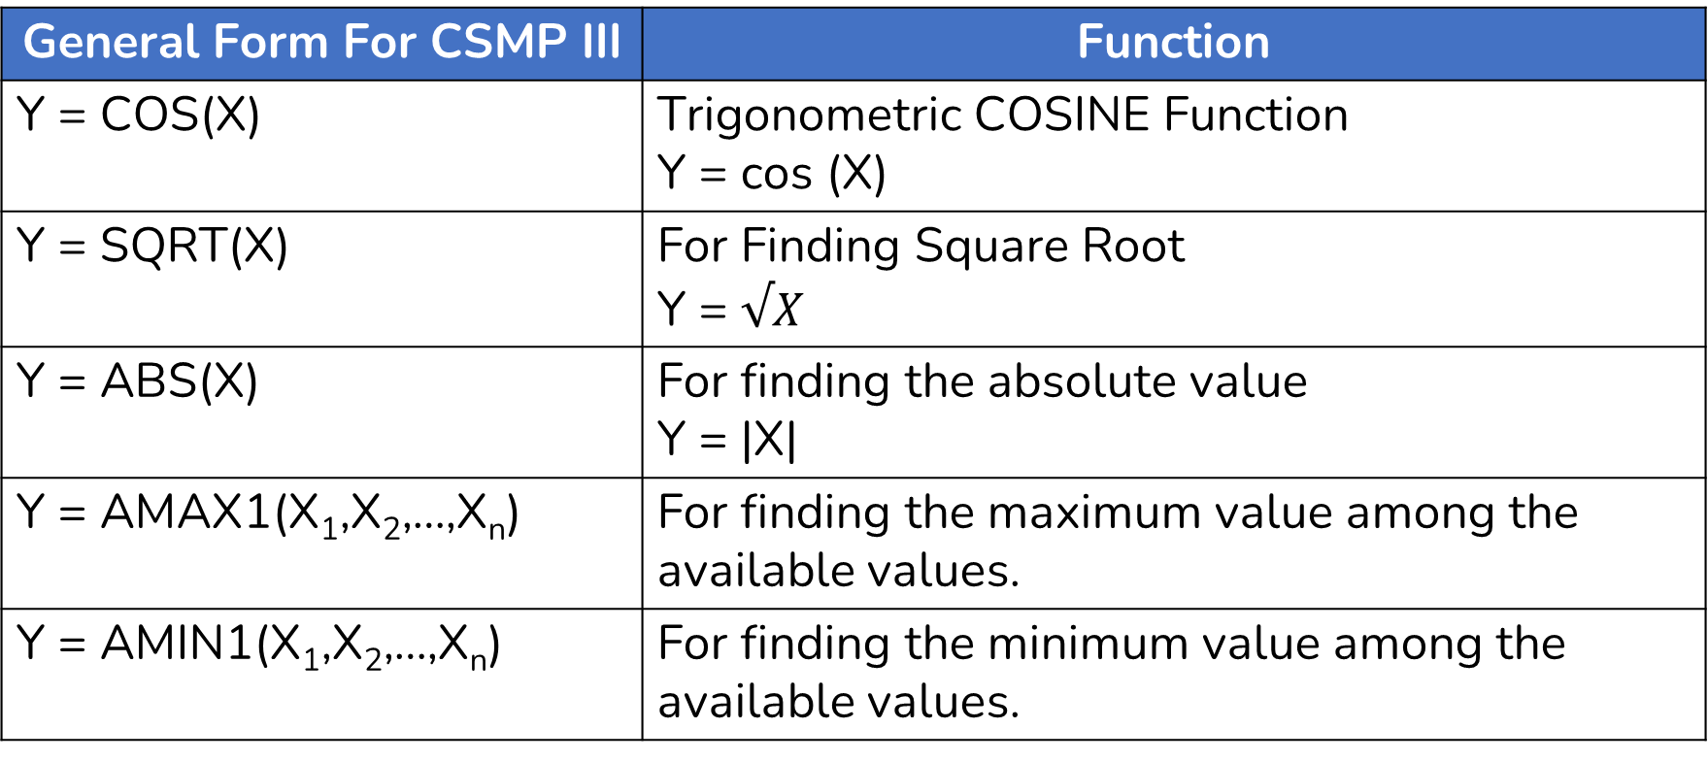
CSMP III Functional Blocks
General Form For CSMP III | Function
Y = COS(X) | Trigonometric COSINE Function Y = cos (X)
Y = SQRT(X) | For Finding Square Root Y = $√X$
Y = ABS(X) | For finding the absolute value Y = |X|
Y = AMAX1(X₁,X₂,…,X_{n}) | For finding the maximum value among the available values.
Y = AMIN1(X₁,X₂,…,X_{n}) | For finding the minimum value among the available values.

Slide 20
End of Lecture 9

Slide 21
Feedback System Interactive System

